Slide 1
Cloud Excellence Presentation
Team Flashcard Learners
Members:
Alvino Villa, Mateusz Marciszewski, Paramjeet Bindra, Steve Tu
Notes:
Abimbola

Slide 2
Deploying a Flashcard Application on AWS
Project Overview
Architecture/Design diagram
Tools/Software Environment used
Challenges/Issues/Problems/Your stories
What have you learned/learned?
What else can we do on the project? - future plan- any design and implementation ideas?
Demo
Questions and answers

Slide 3
Business Value: to be put in Word document/could be used as a slide
A flash card study aid for leveraging technology by giving users the opportunity to update a single file to help their studying.
example: AWS concepts and their explanations
example 2: teaching new hires about Booz Allen Hamilton’s values
By choosing this: you can actually fork the repo to use it as a design study tool and multiple people could be making flashcards
Notes:
Matts slide

Slide 4
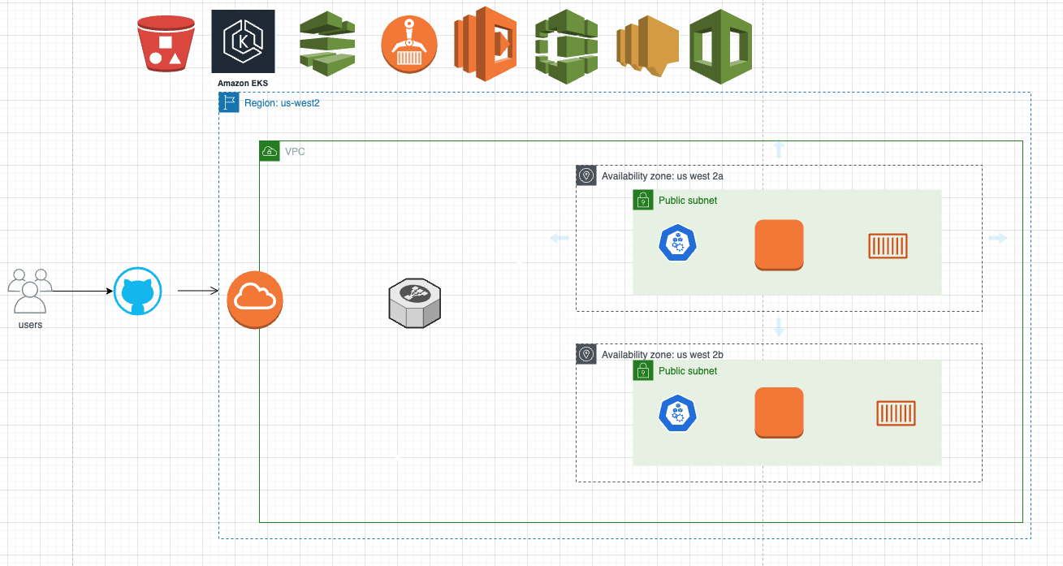
Architecture and Design
Notes:
Paramjeets slide***to speak; use a 2nd architecture slide

Slide 5
Technologies and Environment used
Primary Project:
Github: to host the code
AWS Pipeline: to pull the code and deploy to AWS S3*
AWS CodeBuild: builds new container image and pushes to ECR, code build is running the update
ECR: EKS:
2 solutions and list of each technologies:
Al Backup Project:
Github: to host the code
AWS Pipeline: to pull the code and deploy to AWS S3*
AWS SNS: to notify Lambda of code updates
AWS Lambda: to start instance refresh of an autoscaling group
AutoScalingGroup: rolling update using launch template to deliver new code
Notes:
get Paramjeets input and why he chose these things *write talking puts inside the slide*
*Steves slide now; potential slide on cost****

Slide 6
Challenges and Issues* from our personal team
Challenges:
Choosing a particular CI/CD method
Deciding between ECS/EKS and why?
Issues: below used from the success/failure log
failure in code not deploying after making changes to it despite having AWS CodePipeline up
having two containers and only one was able to run and the other did not
deployed (ALB) Application Load Balancer and only one node was healthy; we didn’t get true load balancing
registry was slow to update; took about 15 minutes
Notes:
Al’s slide and some of Paramjeets slide
IAM policy

Slide 7
Challenges and Issues
What you learned from the other teams: Slide
Keep architecture as simple as possible and stop trying to do too much
Don’t do trunk based development; use pull requests to merge code from a separate branch
Delete the NAT Gateway for private subnets; not cost effective! Don’t leave NAT gateways running
Check all your regions, not just the one you’re working on.
Jenkins errors messages were not helpful nor specific; complicated things.
Understanding roles and AWS credentials?
Goals:
Create everything that is required like Infrastructure as Code and make sure it runs fine like running a sample/our app through the whole process.
then do the add-ons like ECS/EKS or making things better like high availability b/c containers are not required for this project and we can polish the project.
1. Simplicity
2. Cost-effective
Challenges we might expect:
Choosing a particular CI/CD method. So many ways to skin a cat.
Keeping in mind to keep things simple and cost effective
Issues we might expect:
Creating CloudFormation Template.
Notes:
Just example slide from slide 6:
more information****

Slide 8
Demo
*possible video recording
*or just someone showing it in real life for a few minutes but should work!
Notes:
we are recording the demo tomorrow****

Slide 9
Future State - What we would add
-Examples:
-Host the app using ECS and Fargate
-Using AutoScaling
-High Availability
-Private Subnets and NAT Gateway
-ALBs
Notes:
Just what you would do in the future?
-being able to deploy to another region*****and then the pipeline could feed to different regions**** -remove SNS to Lambda dependency
- things to do better with cost efficiency
knowing the real world impact with the things we are playing around with
– get it updated’Steve****

Slide 10
Q & A - Ask us anything

Slide 11
Success/Failure Log: to be put in word document
Successes:
-we were able to commit changes to GitHub and deploy
-authorized GitHub connection settings for the ability to connect to AWS
-ran pipelines successfully
-successes with YAML code***
-
Failures:
-failure in code not deploying after making changes to it despite having AWS CodePipeline up
-having two containers and only one was able to run and the other did not
-deployed (ALB) Application Load Balancer and only one node was healthy; we didn’t get true load balancing
-registry was slow to update; took about 15 minutes
-challenges with YAML code

Slide 12
Artifact Summary: for a separate word document*
List of items:
IAC code, that isn’t part of the pipeline
files names of the files in the repo and list them here
Notes:
go in the repo list the files names*
index.html
.css

Slide 13
Notes:
refresh nothing
EC2 AutoScaling Group: choose desired capacity2 in each AZ, 4 for rolling update
> come with SG and keypair > go through health checks > FlashCards-03 > Pipeline > Source: GitHub > EC2 Launch Template****with the script**** > this will refresh and pull the code > load balancer > FlashCards-ALB-Instance > mapped to the 2 AZs, 1 SG > listeners to the correct to target group > FlashCards TG registered > and voila!!!!
issues ran into: adding a step to call Lambda, it doesn’t have knowledge of the code and doesn’t know when to stop running. > notification rule > sends to SNS > codestar notifications-flash cards > Lambda flashcard deploy; import json, boto3, logging*

